Slide 1
Heartland Initiative
This presentation was made at the IFCA St. Louis Regional in September 2012. Move to next slide to start audio and auto advance.

Slide 2




Enhancing the strength of the Church by equipping for and encouraging toward ministry partnerships
to achieve Great Commission objectives.

Slide 3


Mapping A Regional Plan
Five Essential Steps

Slide 4
Endorsement
MCE
Endorsement
Five Essential Steps

Slide 5
An Engaged Relationship
Church/Regional Contribution
Prayer
Finances

Slide 6
An Engaged Relationship
Church/Regional Contribution
Prayer
Finances
Fellowship
  Regional Exposure Opportunities
  Church Pulpit Opportunities

Slide 7
An Engaged Relationship
Church/Regional Contribution
Prayer
Finances
Fellowship
  Regional Exposure Opportunities
  Church Pulpit Opportunities
MCE Contribution
Churches/Regional
Communication
Training
Encouragement

Slide 8
An Engaged Relationship
Church/Regional Contribution
Prayer
Finances
Fellowship
  Regional Exposure Opportunities
  Church Pulpit Opportunities
MCE Contribution
Churches/Regional
Communication
Training
Encouragement
Plants
Leading
Coordinating
Working

Slide 9
Adoption
Plan
Adoption
MCE
Endorsement
Five Essential Steps

Slide 10




Plan Adoption

Slide 11
Engagement
Project
Engagement
Plan
Adoption
MCE
Endorsement
Five Essential Steps

Slide 12
Project Engagement
Field Identification
Team Assembly
  Role Definition
  Recruitment
  Training
  Appointment
  Administration

Slide 13
Project Engagement
Field Identification
Team Assembly
  Role Definition
  Recruitment
  Training
  Appointment
  Administration
Plant Initiation
  Ministry Plan
    Core Group
    In-reach/Outreach
  Target Date
  Launch

Slide 14
Nurturing
Plant
Nurturing
Project
Engagement
Plan
Adoption
MCE
Endorsement
Five Essential Steps

Slide 15
Plant Nurturing
Fellowship
Counsel/Leadership
Work Completion

Slide 16
Reproduction
Plant
Reproduction
Plant
Nurturing
Project
Engagement
Plan
Adoption
MCE
Endorsement
Five Essential Steps

Slide 17
Plant Reproduction
Plant Again
Build a Movement

Slide 18
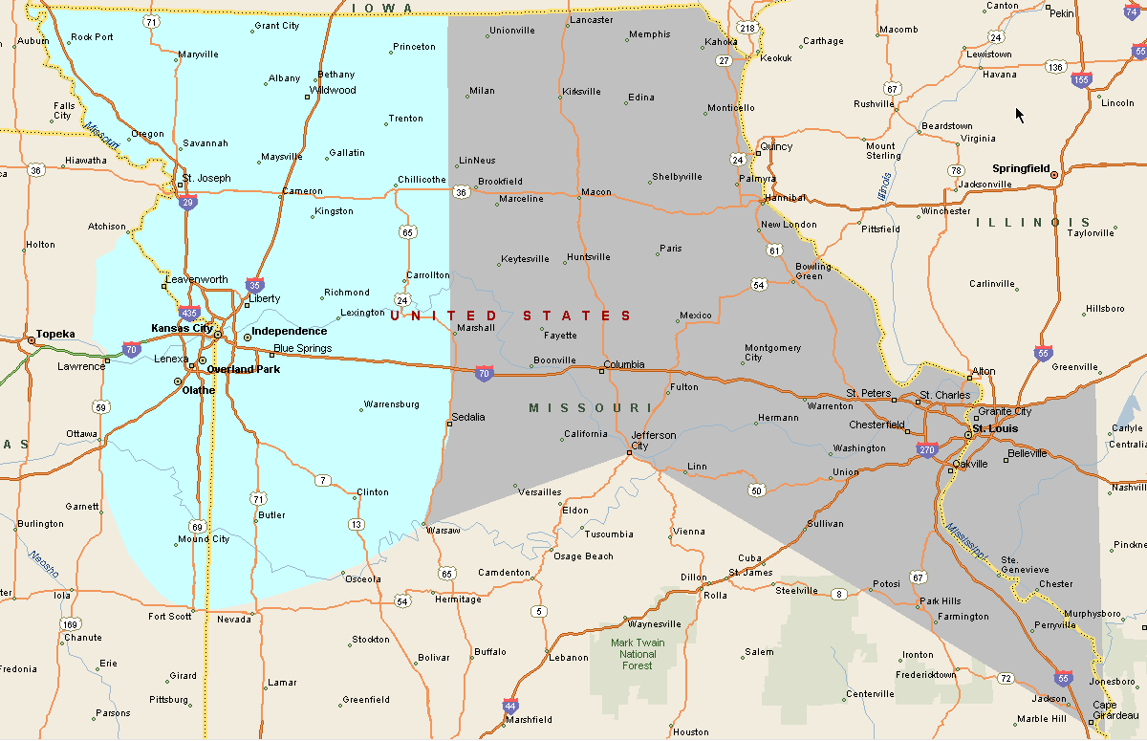

Slide 19
Contact Midwest Church Extension
Henry Vosburgh – Executive Director
Midwest Church Extension
PO Box 337
Remington IN
47977
vosburgh@ifcamce.org
219.714.3672
www.ifcamce.org

