Slide 1
This Powerpoint presentation was presented at the IFCA St. Louis Regional in September 2012
It is 28 minutes in length. Please move to next slide to begin the audio track and auto-advance.

Slide 2




Enhancing the strength of the Church by equipping for and encouraging toward ministry partnerships
to achieve Great Commission objectives.

Slide 3

“…a perpetual
surge of repro-
ductive IFCA
church planting
efforts incorporating the direct involvement of an ever increasing number of IFCA related churches and the IFCA Church Extension agencies throughout the United States.

Slide 4
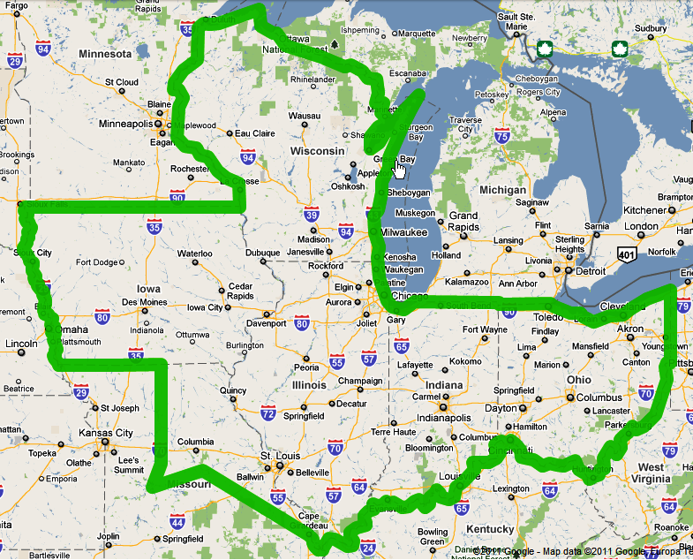

Slide 5
MCESP
  Midwest
  Church
  Extension
  Strategic
  Planning
Organizational efficiency and effectiveness
Relates everything that MCE does to the strategic …
“MCEnd”

Slide 6
MCWhat?
“The permeation of every identifiable Midwestern community with the hope of the Gospel through the biblical ministry of reproductive IFCA International churches.”
MCEnd!

Slide 7
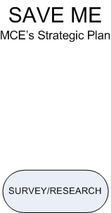

Slide 8
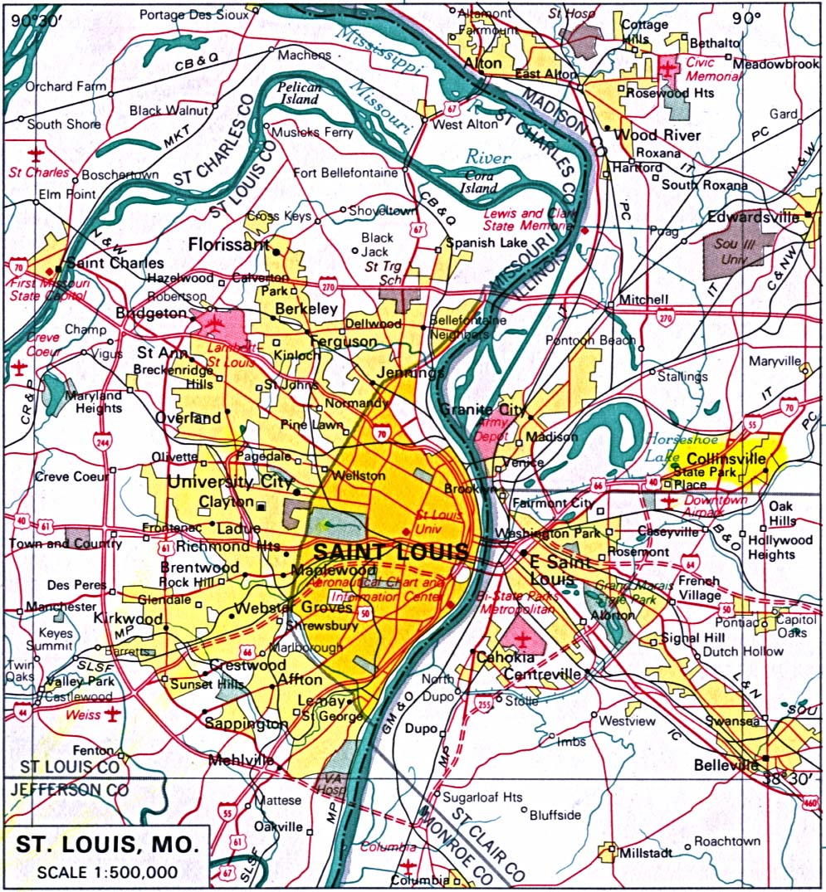
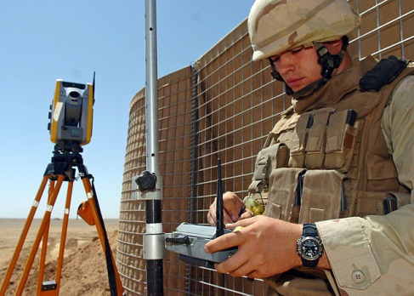
Survey
Population centers
Metropolitan communities
Micropolitan communities
Antepolitan communities
Isopolitan communities

Slide 9
Survey
Population Centers
Demographics
Historical Context
Spiritual Context

Slide 10
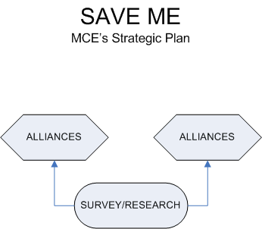

Slide 11

Alliances
With IFCA International entities willing to partner with MCE to accomplish McEND.
What sort of support and to what degree will such
alliances contribute to MCE’s efforts?
  Direct – On site
  Indirect – From a Distance

Slide 12
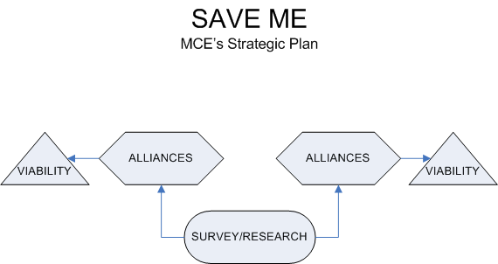

Slide 13
Viability Assessment
PRIORITIZING TARGETS
Un-churched population
Degree of Gospel witness and ministry
Potential for networking
Presence of a "core group"
"Macedonian Call"
Other, including Subjective factors and Divine Direction.
Divine
Direction
Objective
Factors
Subjective
Factors
Priority Target

Slide 14
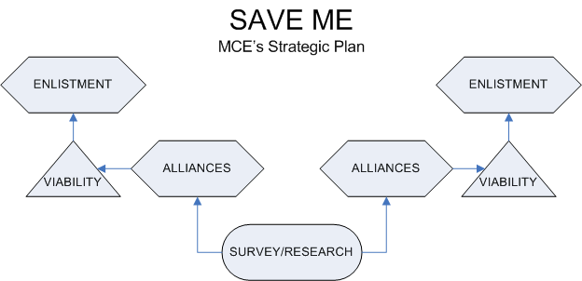

Slide 15

Enlistment
RECRUITING THE MINISTRY FORCE
Plant team support
Prayer
Personnel
Finances
Other

Slide 16
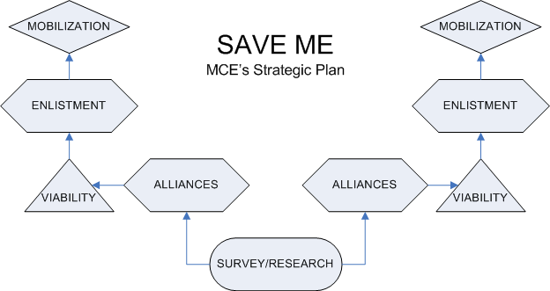

Slide 17
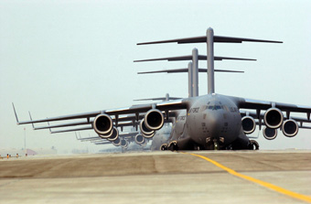
Mobilization
MOBILIZING THE MINISTRY FORCE
Review, assign, place, and coordinate
On site plant personnel
Alliance Resources
MCE Resources

Slide 18
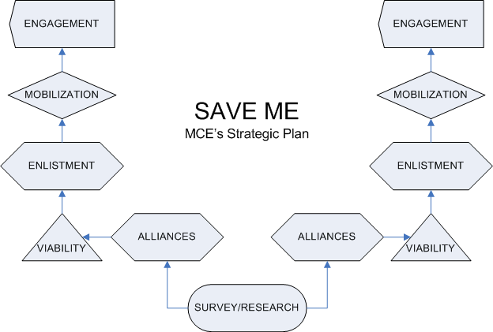

Slide 19
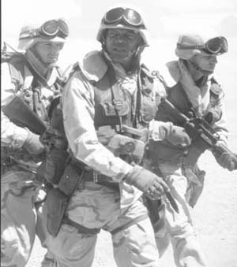
Engagement
The MCE Planting Team Strategy: 4 Phases
Initiate the Plant
Develop the Plant
Complete the Plant
Prepare for the next Plant

Slide 20
4 Phases of Engagement
Initiate the Plant
    Begin worship services
    Begin outreach
    Begin discipleship

Slide 21
4 Phases of Engagement
Develop the Plant
    Building
    Budget
    Board
    Body Life

Slide 22
4 Phases of Engagement
Complete the Plant
    Self-Sustaining
    Self-Perpetuating
    Self-Governing

Slide 23
4 Phases of Engagement
Prepare the Plant
TO PLANT AGAIN!!
    Planting Commitment
    MCESP Training
    Target Area(s)

Slide 24
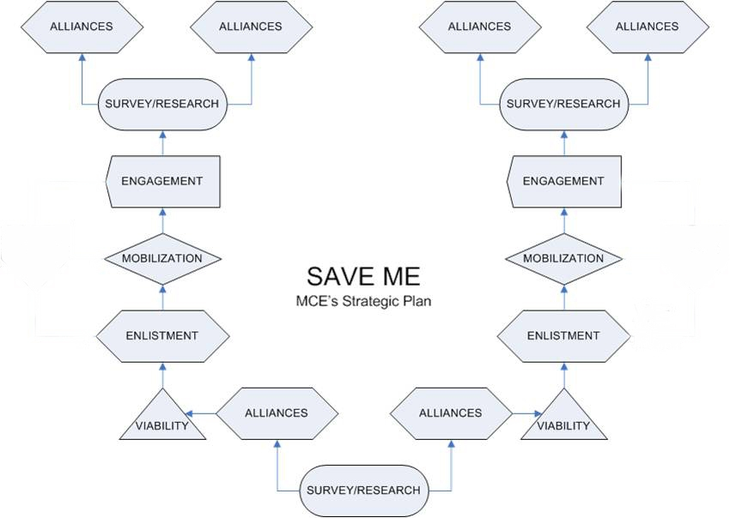

Slide 25
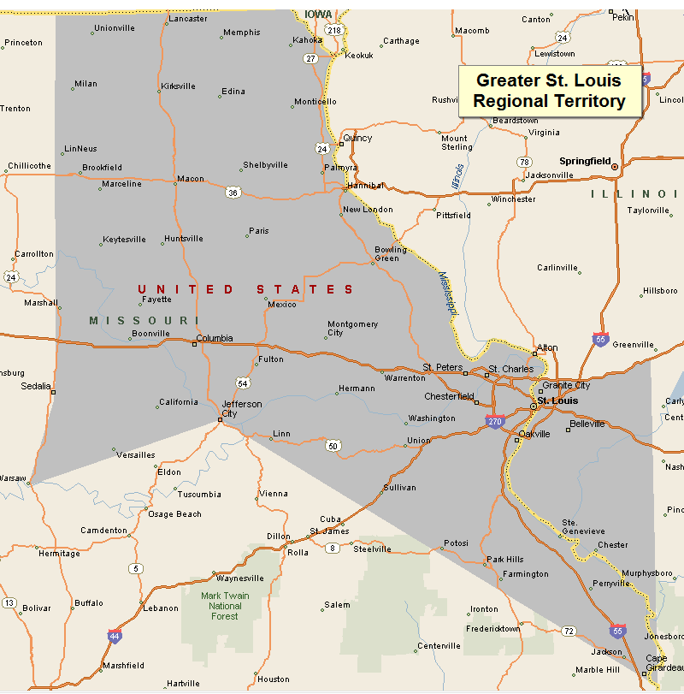

What We Know

Slide 26
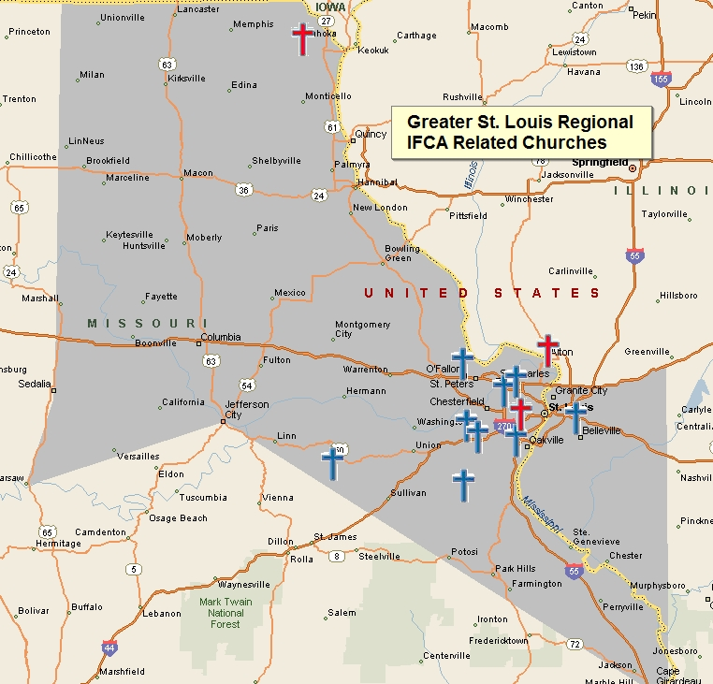
Fairview Heights IL
Alton IL
Dittmer MO
Eureka MO
Wildwood MO
Hazelwood MO
Maryland Heights MO
O’Fallon MO
Owensville MO
St. Louis MO
Kahoka MO
Brentwood MO
12 IFCA Regional Churches
9 Member Churches
3 Associated Churches

Slide 27
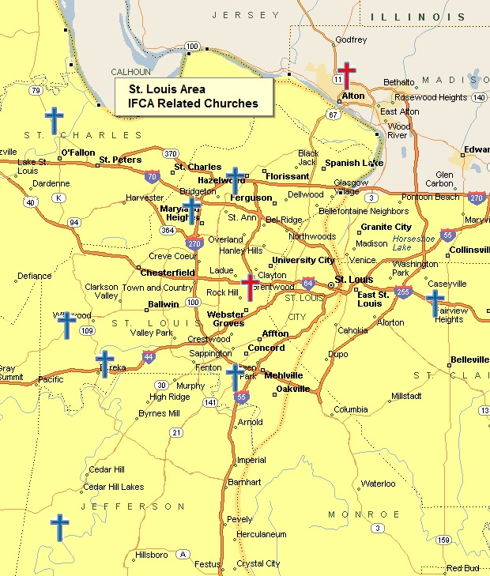
Fairview Heights IL
Alton IL
Dittmer MO
Eureka MO
Wildwood MO
Hazelwood MO
Maryland Heights MO
O’Fallon MO
St. Louis MO
Brentwood MO
10 IFCA Regional Churches
8 Member Churches
2 Associated Churches

Slide 28
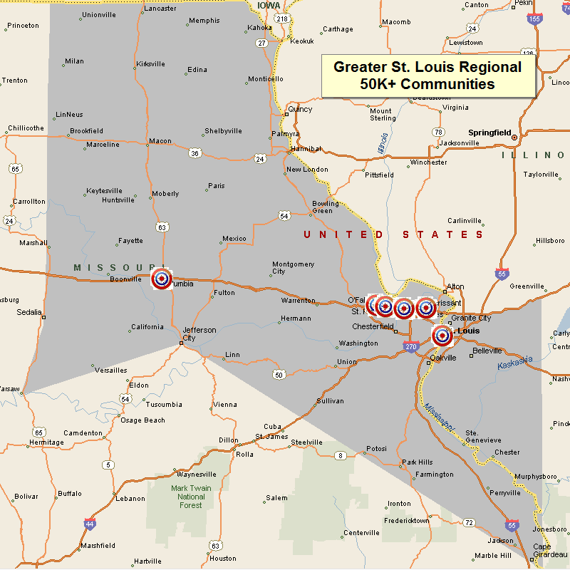
St. Peters
St. Louis
St. Charles
O’Fallon
Florissant
Columbia
677,650 Souls

Slide 29
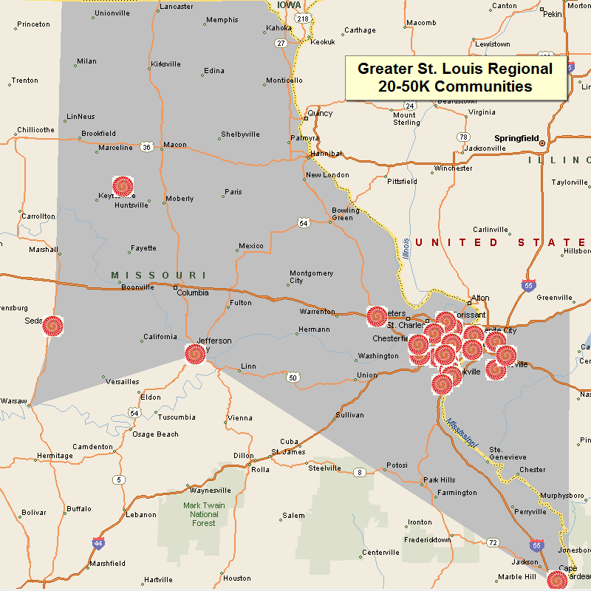
Chesterfield MO
Oakville MO
Wildwood MO
University City MO
Ballwin MO
Wentzville MO
Mehlville MO
Kirkwood MO
Maryland Heights MO
Hazelwood MO
Webster Groves MO
Ferguson MO
Arnold MO
Affton MO
Prairie Village MO
Collinsville IL
East St. Louis IL
Belleville IL
O’Fallon IL
Granite City IL
629,220 Souls

Slide 30
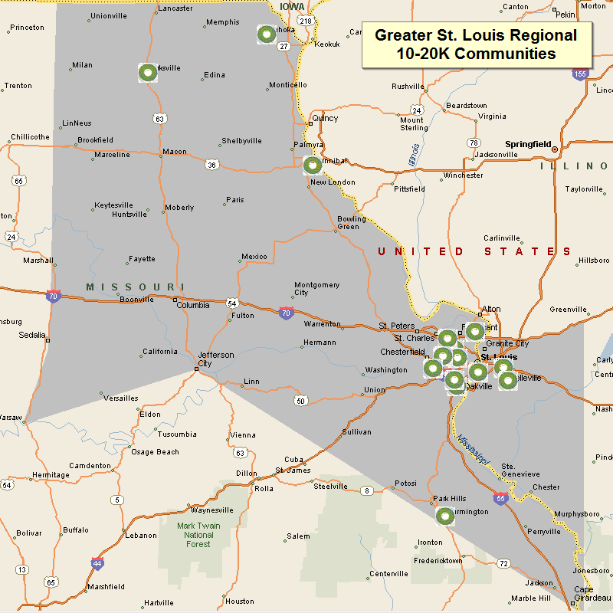
Spanish Lake MO
Manchester MO
Hannibal MO
Creve Coeur MO
Kirksville MO
LeMay MO
Concord MO
Farmington MO
Overland MO
Clayton MO
Bridgeton MO
Swansea IL
Fairview Heights IL
Cahokia IL
228,769 Souls

Slide 31
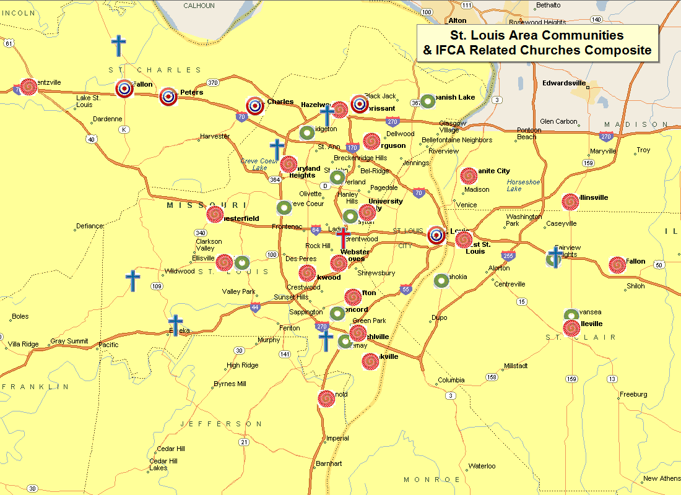
Communities
50K+ (5)
10-50K (30)
Souls
1.29 Million+
- - -
IFCA Ministry
8

Slide 32
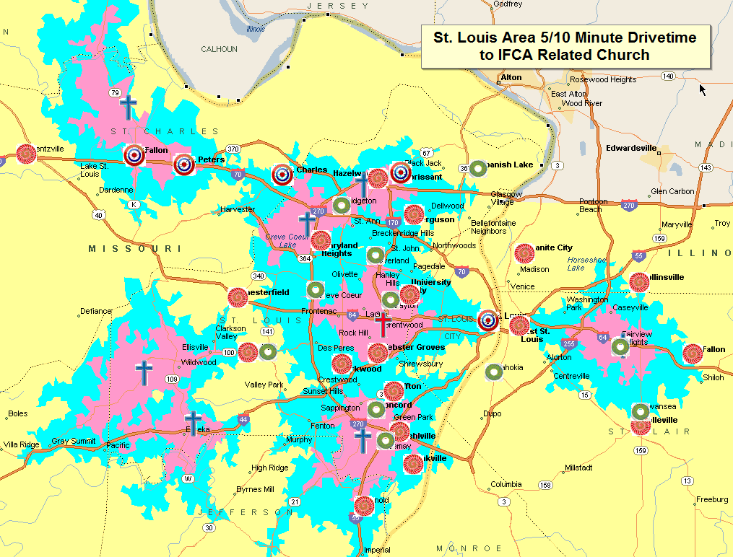

Slide 34
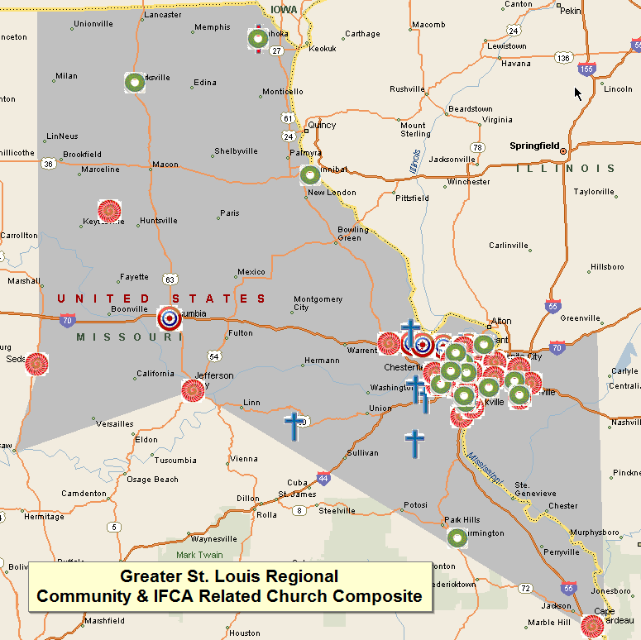

Slide 35
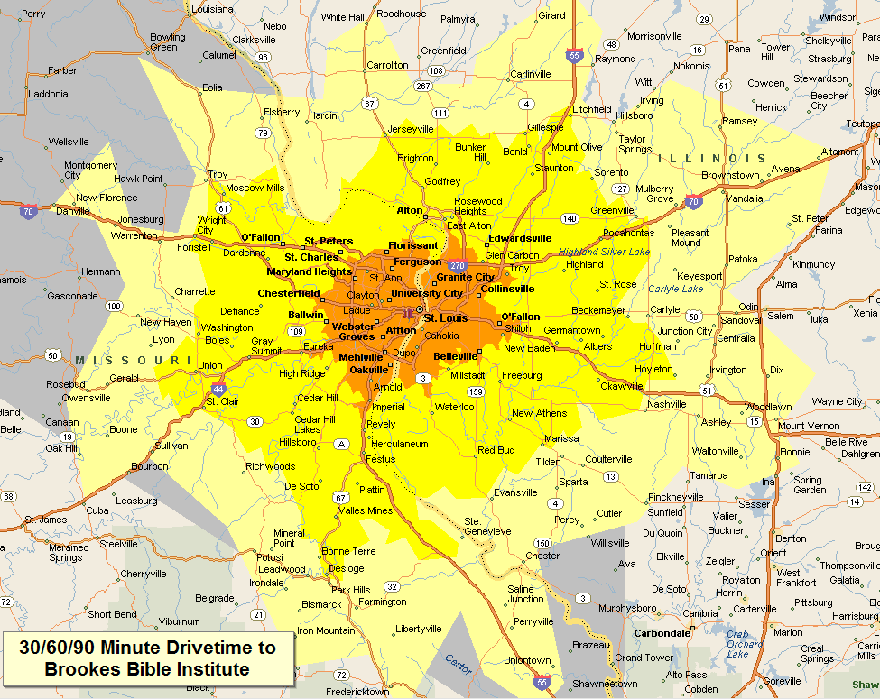

Slide 36
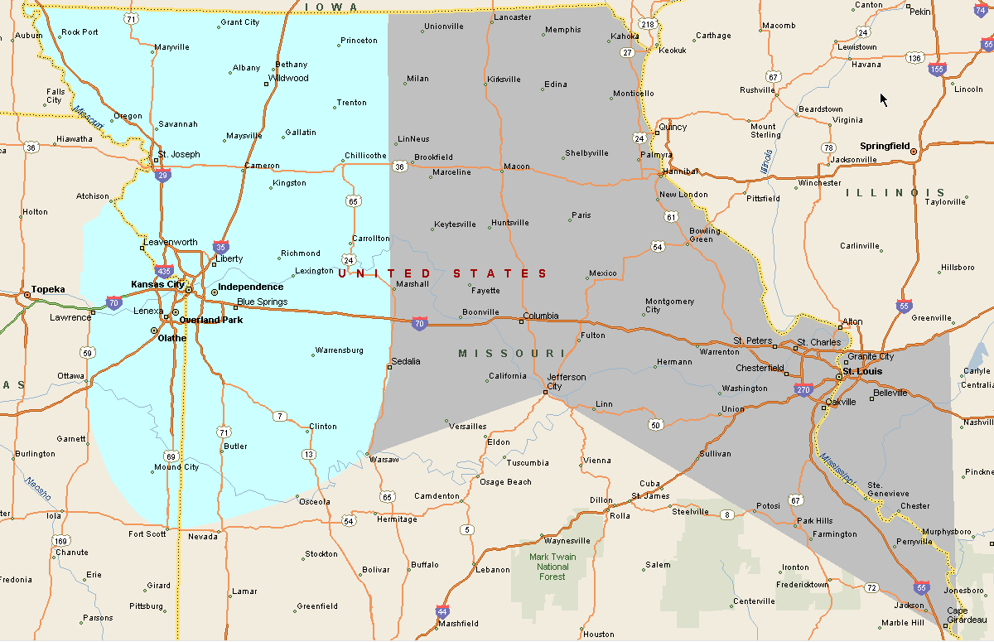

Slide 37
For additional information, contact Midwest Church Extension
Henry Vosburgh, Executive Director
MCE
PO BOX 337
Remington IA 47977
765.714.3672
vosburgh@ifcamce.org
www.ifcamce.org

